Slide 1
Version Control for Game Developers
@TobiahZarlez

Slide 2
Agenda
What is Git?
Why use version control?
Git Basics (Publishing, push/pull, branching)
Advanced Git concepts (Merge conflicts, Merge vs. Rebase)
Fixing mistakes
Git-LFS
GitHub Pull Requests
Contributing to Open Source Software

Slide 3
What is Git?
Git is distributed revision control system created in 2005.
Industry standard for version control and source code management systems.
Completely free!
Various hosting services out there with both free and paid tiers

Slide 4
Who SHOULDN’T use version control?
You have a compulsion and/or truly enjoy manually zip and copy/paste everything you do at least 3-5 times an hour.
You have unlimited hard drive space to store older versions
No other member of your team will write code at the same time as you.
Never want to show off progress/test build while you or a team member is in the middle of building an additional feature
You have a perfect memory for when any member of your team last touched any part of your codebase.
Your computer will never crash and/or never be stolen.
Write flawless code that always works the first time and never introduce bugs

Slide 5
GitHub
Repo
Codebase v3
Codebase v2
Codebase v1
Remote
1
Remote
2
Remote
3
Notes:
Can anyone tell me why this isn’t good?

Slide 6
How does Git actually work?
Fork1
GitHub
Base
GitHub
Fork1
GitHub
Repo
Repo
Repo
Local
Git
Local
Git
Local
Git
Repo
Repo
Repo

Slide 7
How does Git actually work? (Simple)
GitHub(origin)
Remote:
Repo
“Push” code from local, to remote
“Pull” code from remote, to local
Local
Git
Repo

Slide 8
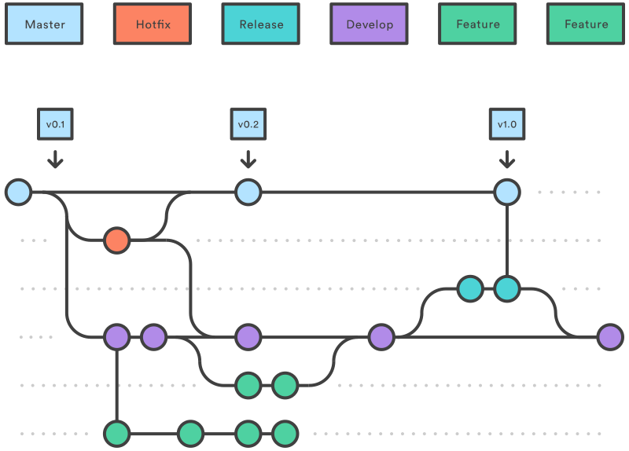
What’s in a repo?

Slide 9
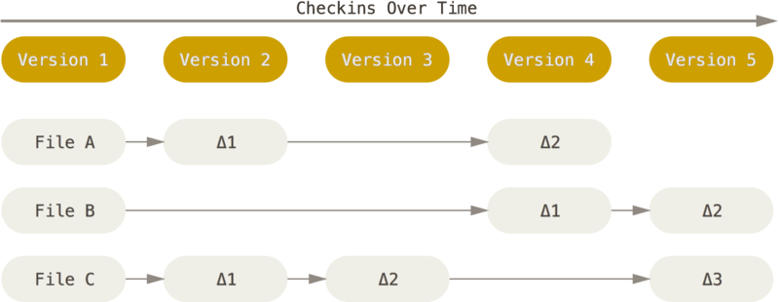
Git is a series of changes

Slide 10
Git is both simple and complicated

Slide 11


You too can be like these dogs!
Notes:
One of the things you need to do after all is git fetch

Slide 12
Trigger Warning: CLI ahead

Slide 13

The problem with using GUI tools

Slide 14
DEMO time!
Setup / Git config
git config --global user.name “Tobiah Zarlez“
git config --global user.email TobiahZ@Microsoft.com
Publish and Clone
Push and Pull
Ignore Files

Slide 15
Discard local changes
Reset local change (Discard)
Git clean –f
Git reset --hard HEAD

Slide 16

Git Revert: All you need!
Syntax: git revert <commit SHA>
Easy to do
No worries about changing history
Can revert the revert

Slide 17
Branching and Merging 101

Slide 18
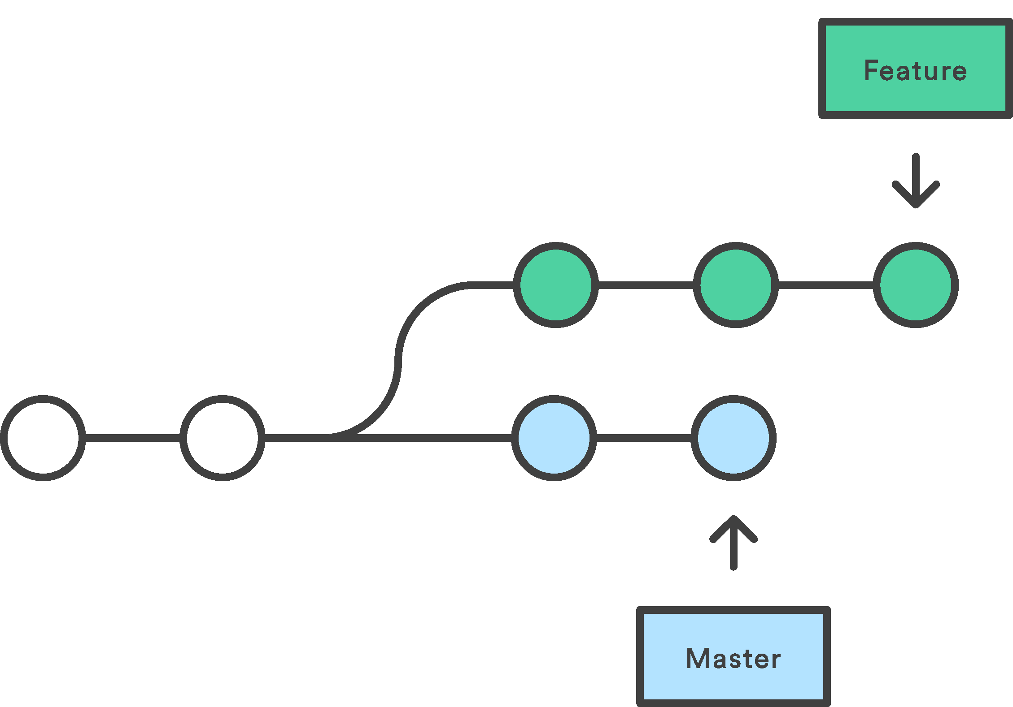
Merge vs. Rebase

Slide 19
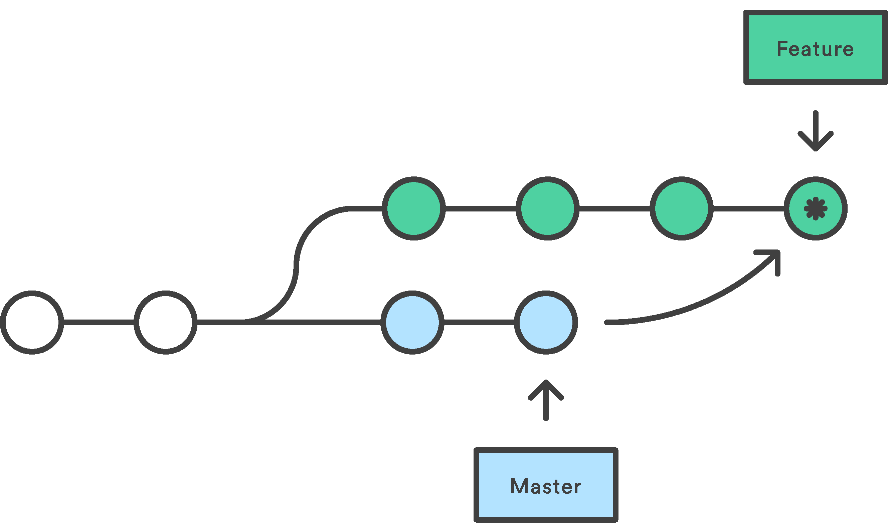
Merge

Slide 20
What if I want to change history?

Slide 21
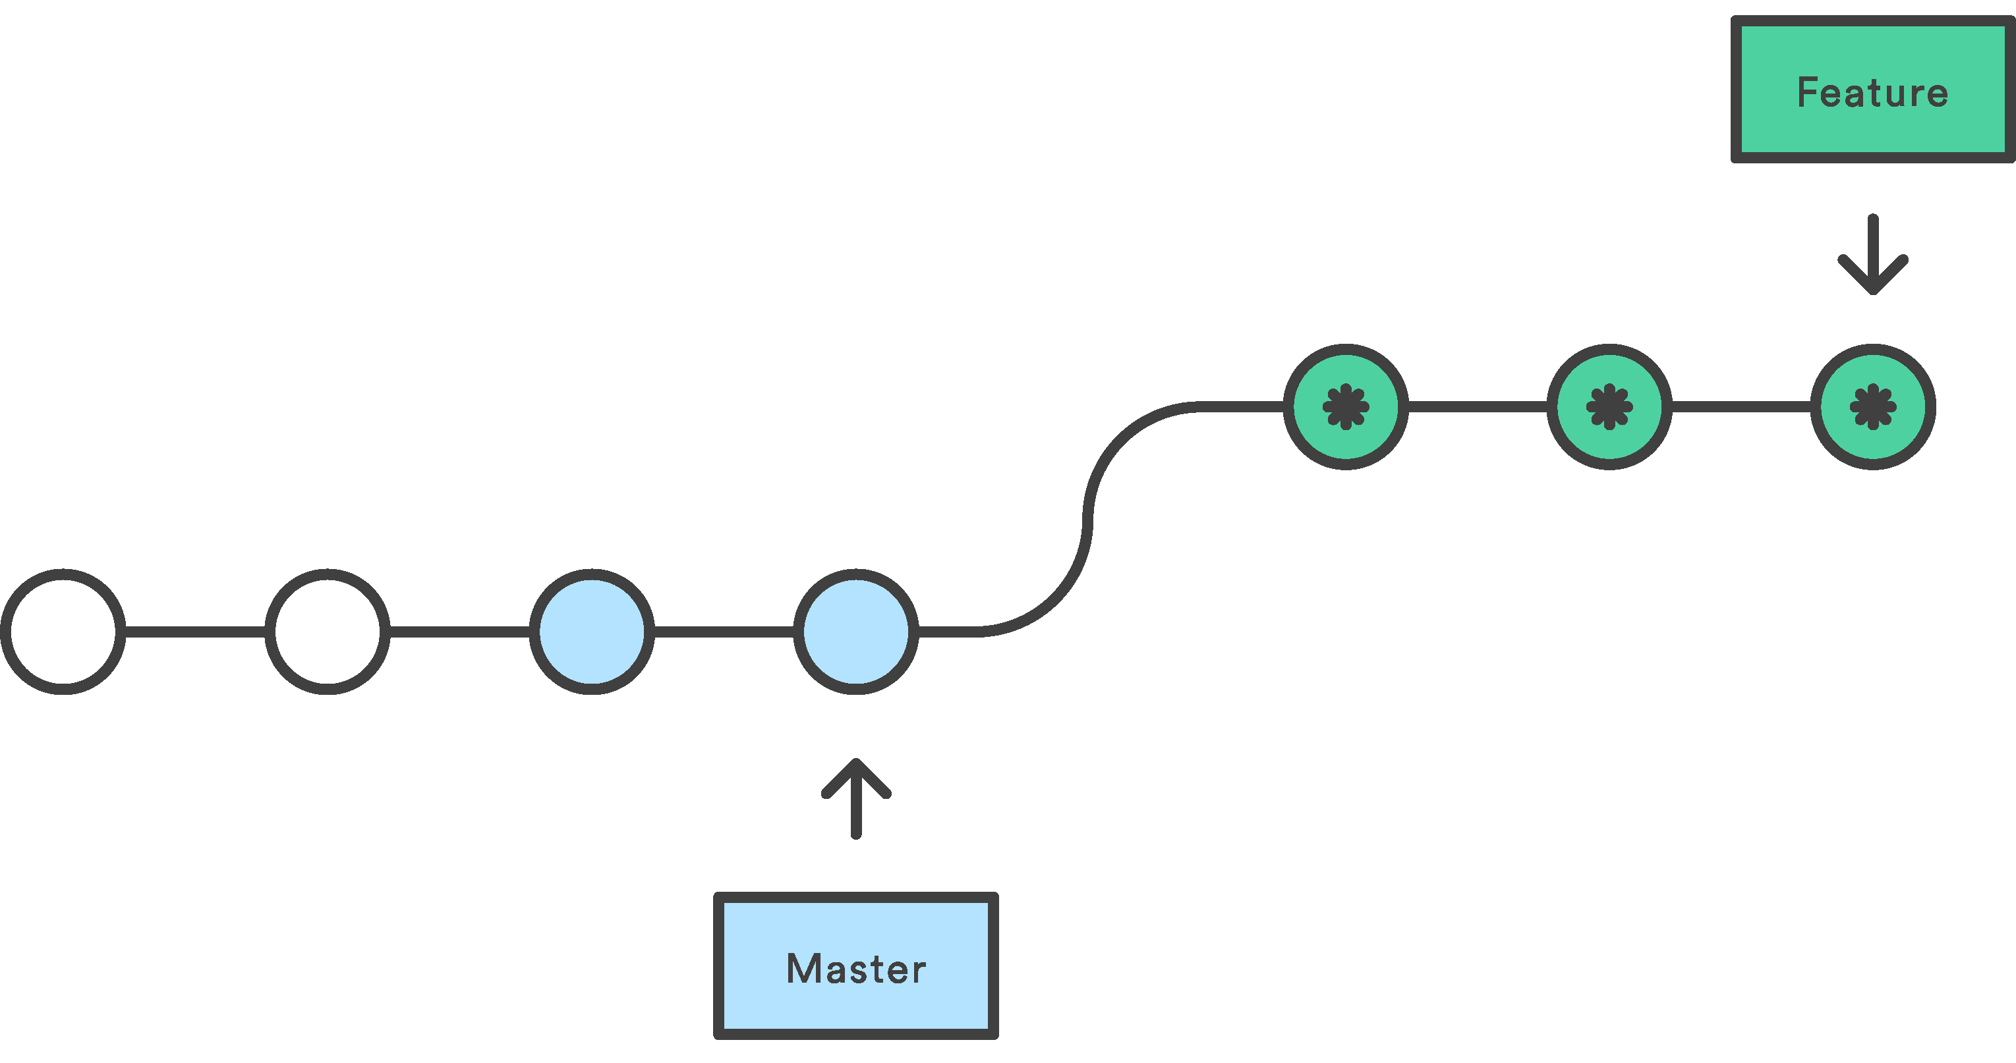
Rebase

Slide 22
Don’t change shared history

Slide 23
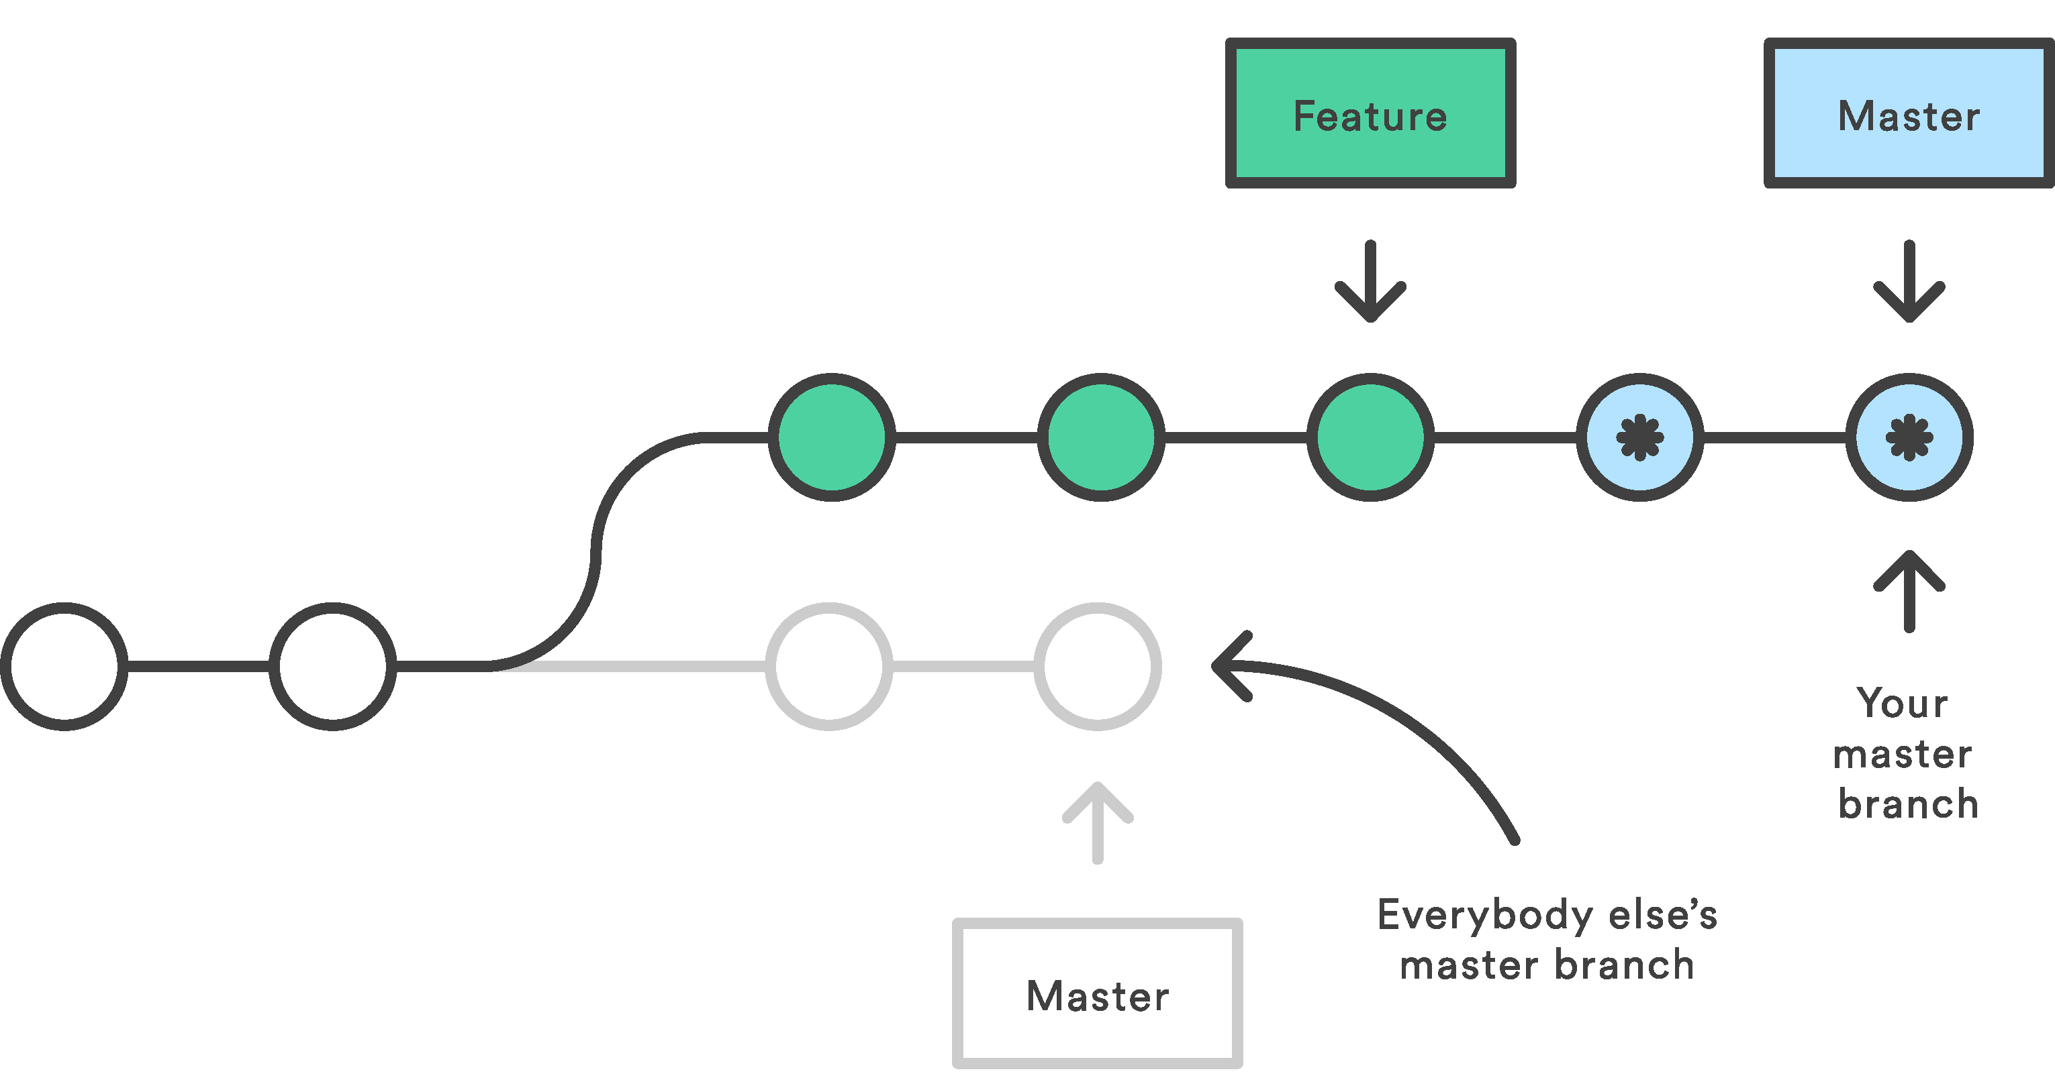
Danger of Rebase

Slide 24
Git-LFS for binary files
Notes:
GitHub
1gb Storage and 1gb bandwidth
$5 a month for 50gb more
Visual Studio Team Services:
Free unlimited

Slide 25
How to install Git-LFS
Download from https://git-lfs.github.com/
Run the command “ $ git lfs install ”
Note:
Service must support it
Must be installed locally

Slide 26
Track files types
In your repo, for each file type:
$ git lfs track "*.psd“
Will create a .gitattributes file

Slide 27
Commit and push
Remember to commit your .gitattributes
$ git add .gitattributes
$ git commit -m “Added .gitattributes”
Then add and commit as usual!
$ git add file.psd
$ git push origin master
$ git commit -m “Added psd file”

Slide 28
Pull Requests
What are they?
How do I make one?
Best practices for OSS

Slide 29
Resources
Try it yourself:
try.github.io
My info:
@TobiahZarlez
www.TobiahZ.com
Contributing to Open Source
https://egghead.io/courses/how-to-contribute-to-an-open-source-project-on-github
https://ponyfoo.com/articles/art-of-pull-request
Software/Tools
Git-LFS - https://git-lfs.github.com/
VSCode - https://code.visualstudio.com/
Meld - http://meldmerge.org/
Repositories
GitHub's Git Ignore repository - https://github.com/github/gitignore

